Slide 2
CSI 300 Index Volatility Forecasting and Application
China Universal Asset Management Index and Quantitative Department
Sean Xiang

Slide 3
Question
How to use historical time series data to forecast CSI 300 Index volatility over next 30 trading days and 90 trading days?

Slide 4
Catalog
1.Volatility Definition
2.Volatility Classification
3.Volatility Forecasting and Application

Slide 5
Catalog
1.Volatility Definition
2.Volatility Classification
3.Volatility Forecasting and Application

Slide 6
In finance, volatility (symbol σ) is the degree of variation of a trading price series over time as measured by the standard deviation of logarithmic return.
Standard deviation =/= Risk

Slide 7


For any fund that evolves randomly with time, The square of volatility is the variance of the sum of infinitely many instantaneous rate of return, each taken over the nonoverlapping, infinitesimal periods that make up a single unit of time.
If daily logarithmic returns of a stock have a standard deviation of σ_{daily} and the time period of returns is P in trading days, the annualized volatility is
A common assumption is that P = 252 trading days in any given year
Where X_{i} = ln(x_{i}/x_{i-1} )

Slide 8
Catalog
1.Volatility Definition
2.Volatility Classification
3.Volatility Forecasting and Application

Slide 9
Volatility can be classified into these categories:
Implied Volatility
Historical Volatility
Realized Volatility
Forecast Volatility
Ultra High Frequency Volatility

Slide 10
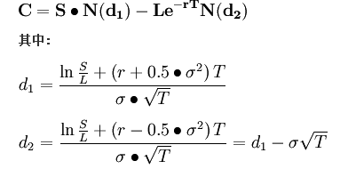

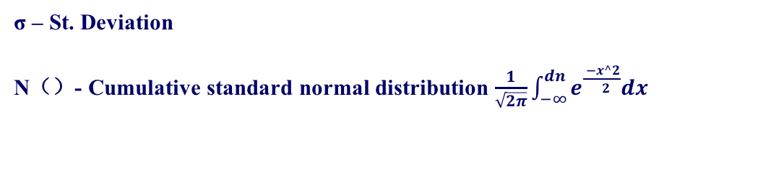
Implied Volatility
A European call option using B-S pricing model:
C – Call premium
L – Option striking price
S – Current stock price
T – Time until option exercise
r – Risk-free interest rate
σ – St. Deviation
N（）- Cumulative standard normal distribution $\frac{1}{\sqrt{2π}}\int_{−∞}^{dn}{e^{\frac{ −x^2}{ 2}}dx}$

Slide 11
Implied Volatility
The implied volatility of an option contract is that value of the volatility of the underlying instrument which, when input in an option pricing model will return a theoretical value equal to the current market price of the option
If the values of S, K, T, r, and C are all known, then can be used to compute the σ predicted by the B-S model
The solution σ, called implied volatility

Slide 12
Volatility can be classified into these categories:
Implied Volatility
Historical Volatility
Realized Volatility
Forecast Volatility
Ultra High Frequency Volatility

Slide 13

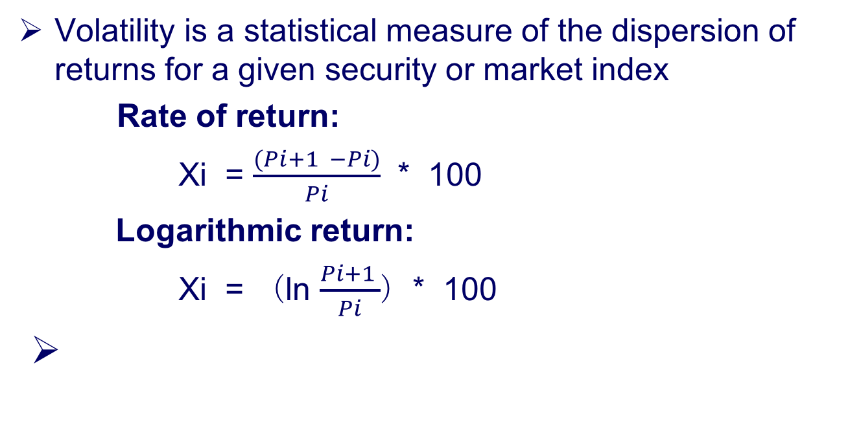
Historical Volatility
Volatility is a statistical measure of the dispersion of returns for a given security or market index
Rate of return:
Xi = $\frac{(Pi+1 −Pi)}{Pi}$ * 100
Logarithmic return:
Xi = （ln $\frac{Pi+1 }{Pi}$）* 100

Slide 14
Volatility can be classified into these categories:
Implied Volatility
Historical Volatility
Realized Volatility
Forecast Volatility
Ultra High Frequency Volatility

Slide 15
OHLC Model Estimators
OHLC model, short for "Opening Price, High Price, Low Price, Closing Price", is developed to estimate market volatility

Slide 16

Parkinson Estimator
Estimate the historical volatility of an underlying based on high and low prices
Empirically, as sample size amounts to over two hundred, the ratio of Parkinson Variance and True Variance approaches one

Slide 17

German-Klass Estimator
Estimate historical volatility assumes Brownian motion with zero drift and no opening jumps (i.e. the opening = close of the previous period)
This estimator is 7.4 times more efficient than the close-to-close estimator.

Slide 18

Rogers and Satchel Estimator
The Roger and Satchell historical volatility estimator allows for non-zero drift, but assumed no opening jump

Slide 19
Yang-Zhang Estimator
The Yang and Zhang historical volatility estimator has minimum estimation error, and is independent of drift and opening gaps
It can be interpreted as a weighted average of the Rogers and Satchell estimator, the close-open volatility, and the open-close volatility

Slide 20

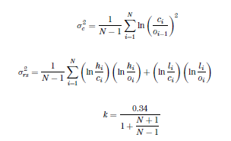
Yang-Zhang Estimator

Slide 21
Volatility can be classified into these categories:
Implied Volatility
Historical Volatility
Realized Volatility
Forecast Volatility
Ultra High Frequency Volatility

Slide 22
Forecast Volatility
Simple Moving Average (SMA)
Weighted Moving Average (WMA)
Exponential Weighted Moving Average (EWMA)
Time Series (ARCH / GARCH(1,1) Model)

Slide 23
Volatility can be classified into these categories:
Implied Volatility
Historical Volatility
Realized Volatility
Forecast Volatility
Ultra High Frequency Volatility

Slide 24
Ultra High Frequency Volatility
High frequency data refers to any time series data with updates that occur in less than fractions of a second.
It potentially reflects more information than low frequency data
Also known as tick-by-tick data

Slide 25
Catalog
1.Volatility Definition
2.Volatility Classification
3.Volatility Forecasting and Application

Slide 26
Question Revisit
How to use historical time series data to forecast CSI 300 Index volatility over next 30 trading days and 90 trading days?

Slide 27
Data Collecting
Source: Wind Financial Terminal
Data: Historical daily return on CSI 300 index, which tracks the Shanghai and Shenzhen Markets
Time: 2007/7/4 - 2017/8/4
Indicator(s): Opening price, High price, Low price, Closing price, Volume

Slide 28
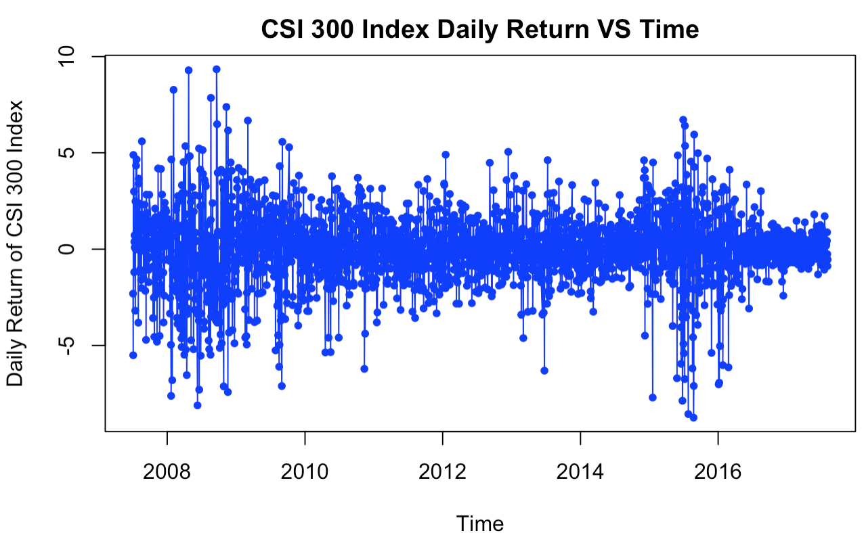
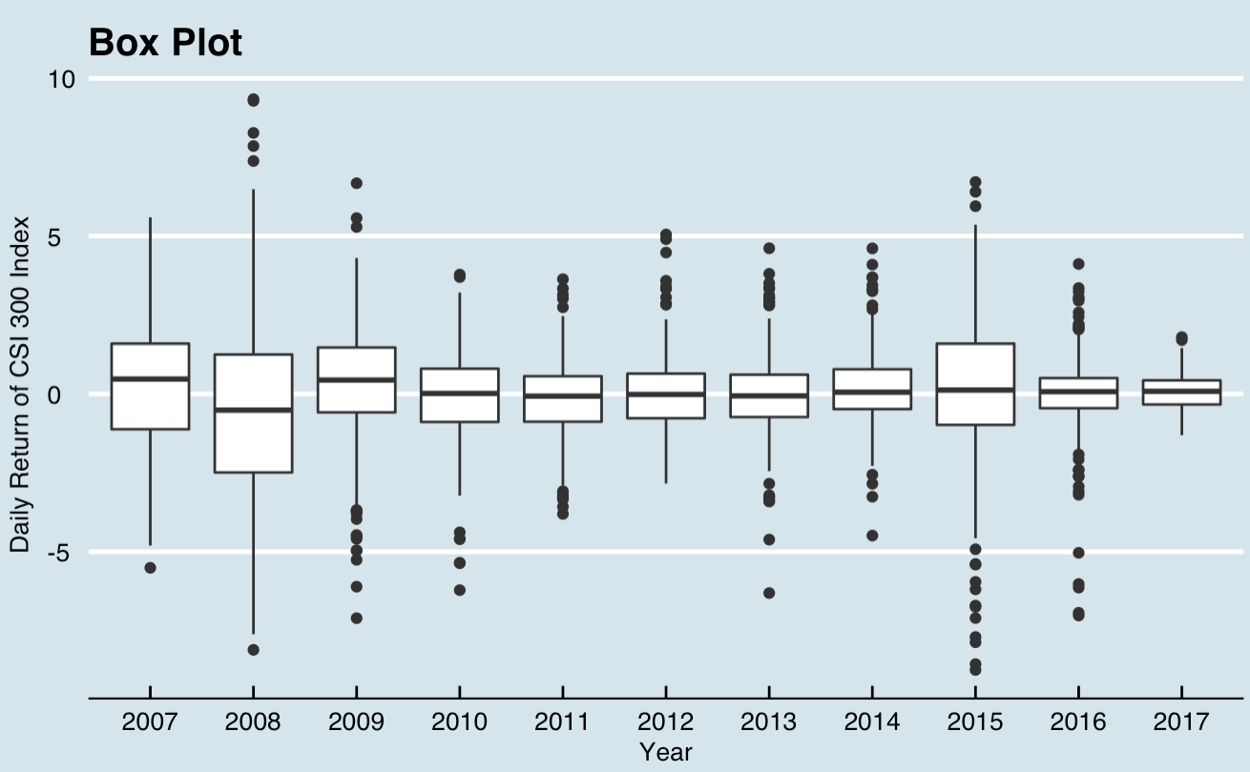

Slide 29


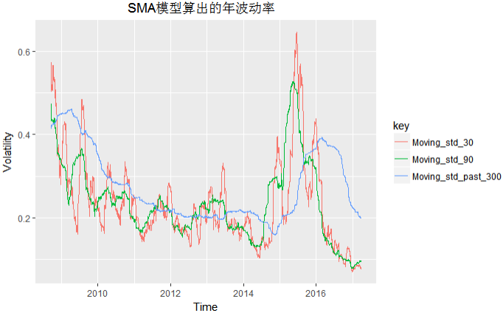
Simple Moving Average (SMA)
Formula:
Ｎ＝300

Slide 30
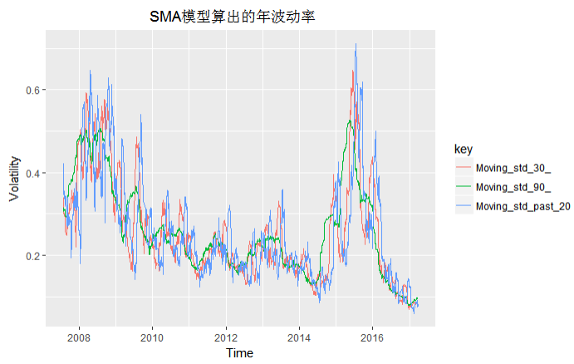
Simple Moving Average (SMA)
Ｎ＝20

Slide 31
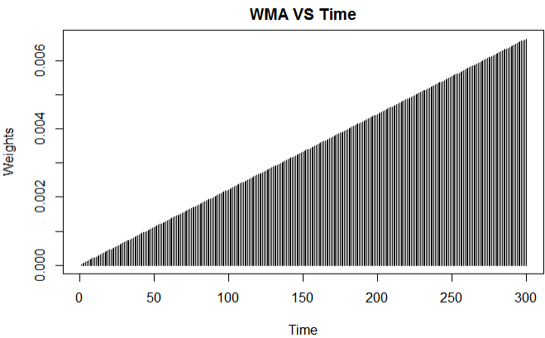

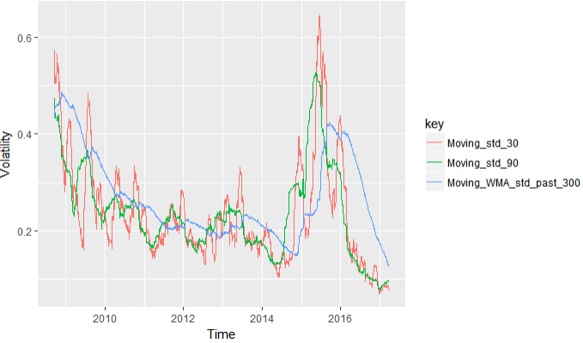
Weighted Moving Average (WMA)
Formula:
Ｎ＝300

Slide 32
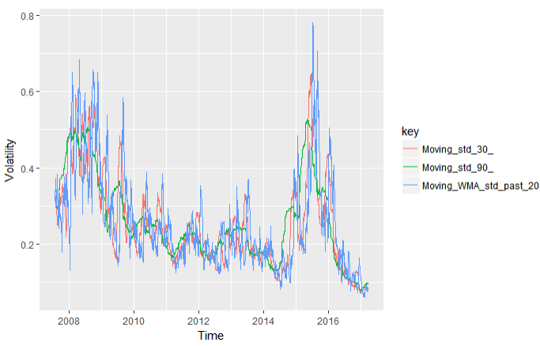
Weighted Moving Average (WMA)
N = 20

Slide 33
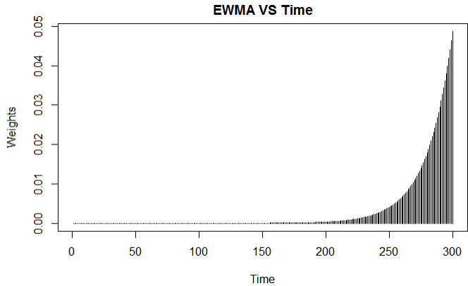

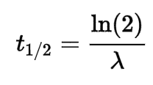
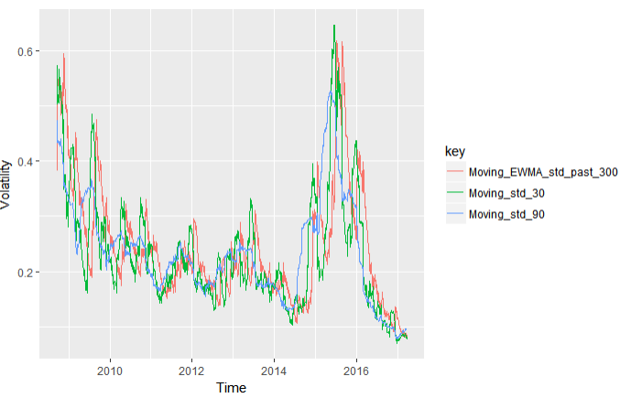
Exponential WMA(EWMA)
Formula:
N = 300

Slide 34
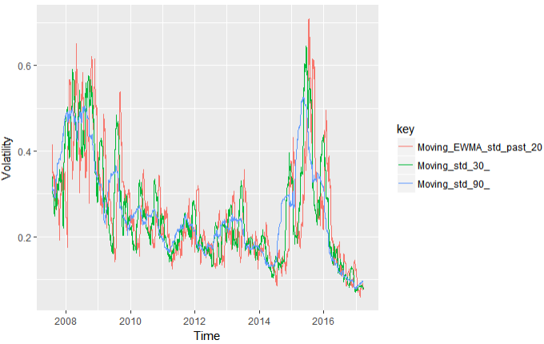
Exponential WMA(EWMA)
N = 20

Slide 35
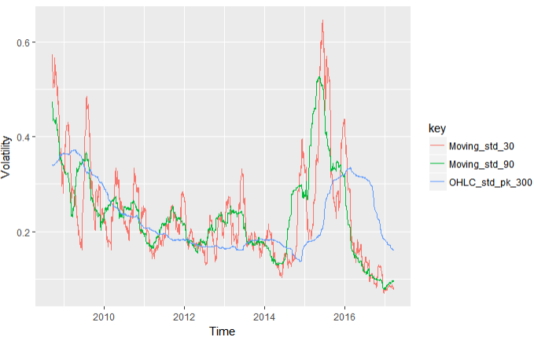
Parkinson Estimator
Formula:
N = 300

Slide 36
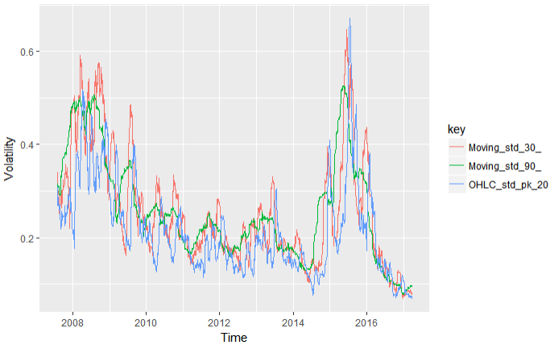
Parkinson Estimator
N = 20

Slide 37
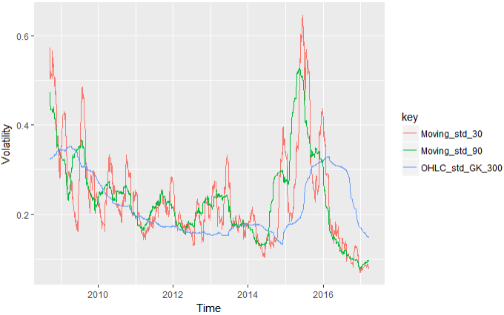
German-Klass Estimator
Formula:
N = 300

Slide 38
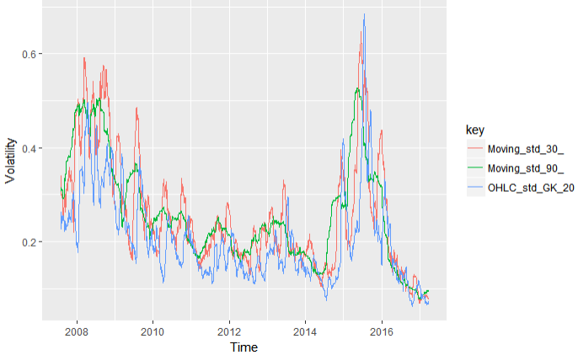
German-Klass Estimator
N = 20

Slide 39
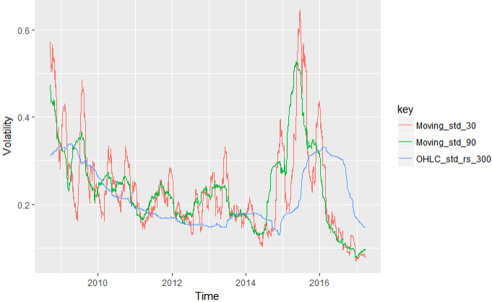
Rogers and Satchel Estimator
Formula:
N = 300

Slide 40
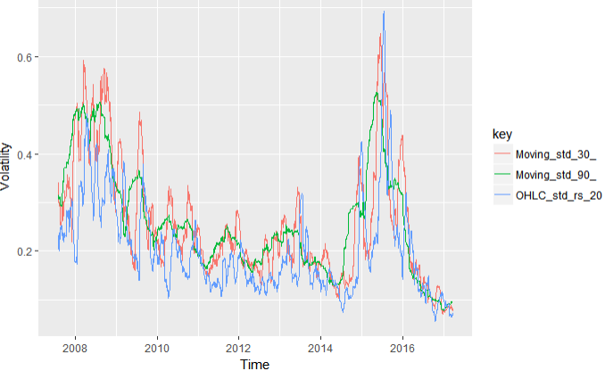
Rogers and Satchel Estimator
N = 20

Slide 41
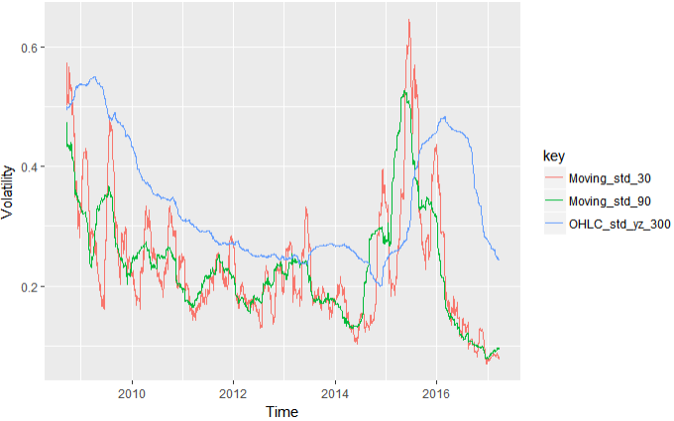
Yang-Zhang Estimator
N = 300

Slide 42
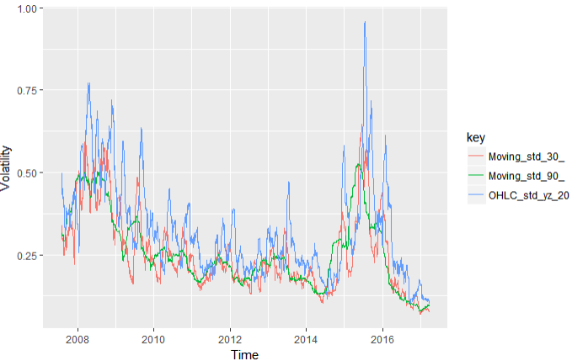
Yang-Zhang Estimator
N = 20

Slide 43
Error Index
Measure 1：
Ρ= Mean(abs(sr1 – sr2)) * 100
Measure 2：
Ρ= Mean(sr1 – sr2) * 100
Where: sr2 is rolling volatility series in next 30 days or 90 days

Slide 44


Next 30 Days
Measure 1 Mean(abs(sr1 – sr2)) * 100
Measure 2 Mean(sr1 – sr2) * 100

Slide 45


Next 90 Days
Measure 1 Mean(abs(sr1 – sr2)) * 100
Measure 2 Mean(sr1 – sr2) * 100

Slide 46
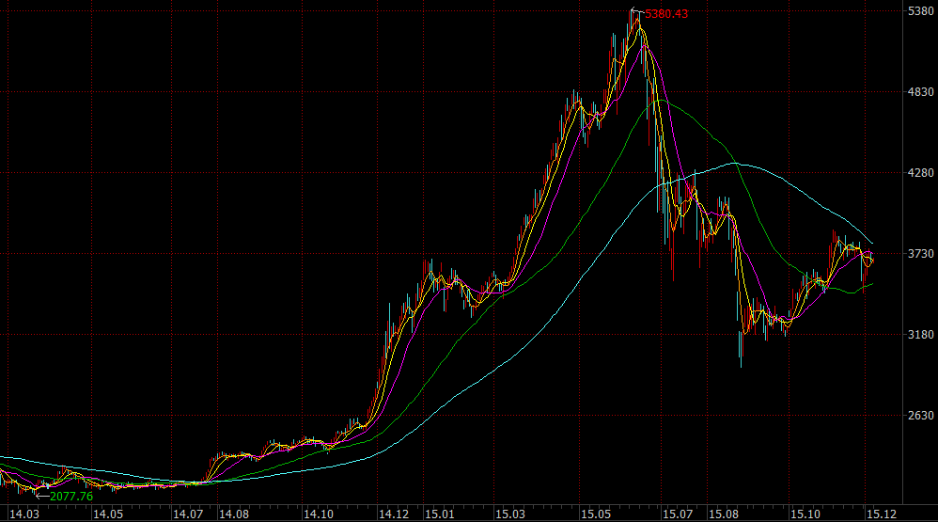
CSI 300 Index

Slide 47
Primary Trends
Bull Market
Time: 2014/11/20 ---2015/6/9
Bear Market
Time: 2015/6/9 --- 2015/8/26
Flat Market
Time: 2014/4/28 --- 2014/7/17

Slide 48
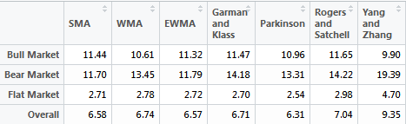
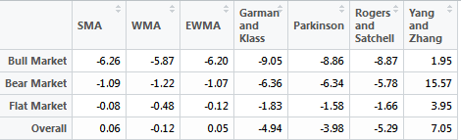
Next 30 Days
Measure 1 Mean(abs(sr1 – sr2)) * 100
Measure 2 Mean(sr1 – sr2) * 100

Slide 49
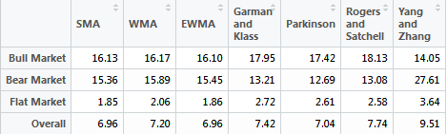
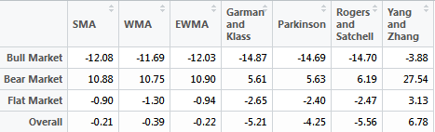
Next 90 Days
Measure 1 Mean(abs(sr1 – sr2)) * 100
Measure 2 Mean(sr1 – sr2) * 100

Slide 50
Summary
Parkinson model systematically underestimates volatility
EWMA and Parkinson models have the smallest index error in both bear market and flat market
Yang and Zhang model has the smallest index error in bull market, but such model perform poorly (oftentimes overestimate volatility) in other market trends

Slide 51
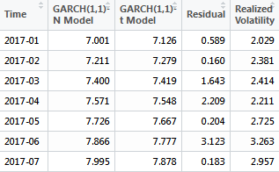
Time Series / ARCH Garch(1,1) Model
Goal: Take CSI 300 Index daily return from 2007/7/4 to 2016/12/30 as sample data, use Garch(1,1) model to forecast monthly volatility in 2017, and compare the result to realized volatility

Slide 52
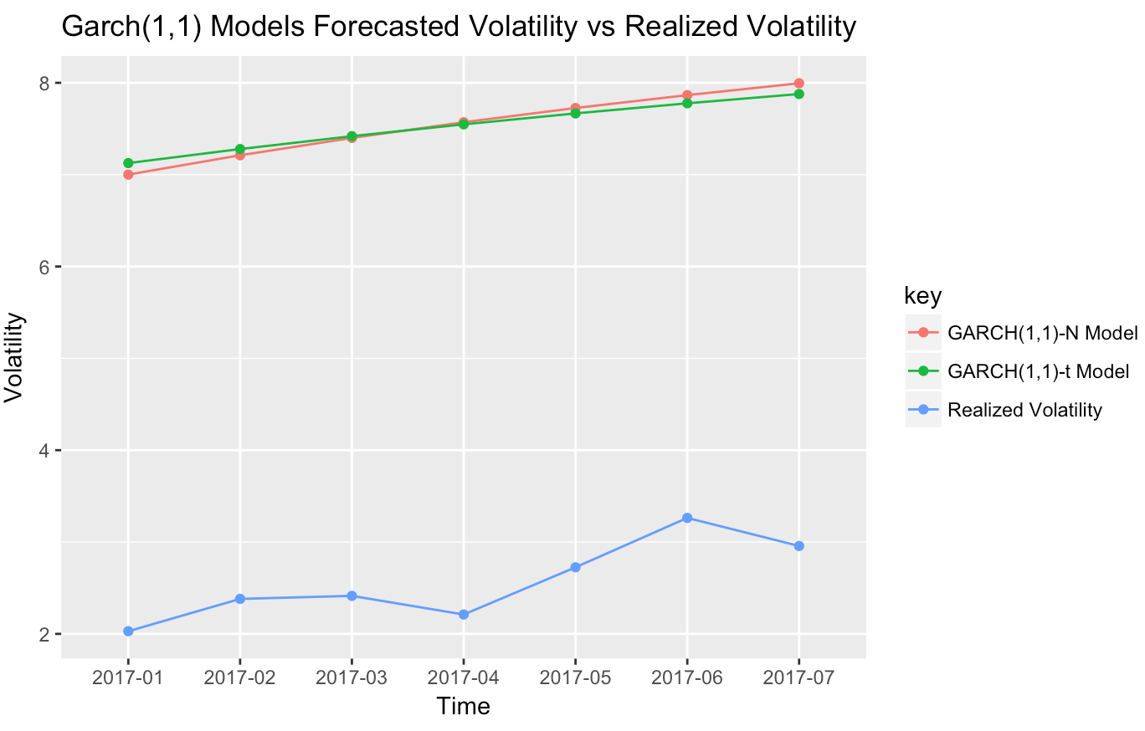
Time Series / Garch(1,1) Model

Slide 53
Further Improvement
Choose the optimal half life that will closely approximate forecasted volatility to realized one
Weight these forecasted volatility directly would be an option worth considering in the future in order to get better estimated result
Break down the market based on the market trends and give analysis to every each of them because a model comes in handy in one season may perform poorly in the other

